Slide 1
TECH ARTEMIS GRAPH Data model
ADDING A GRAPH DATA MODEL INTO OUR STUDENT CO OP WEBSITE

Slide 2

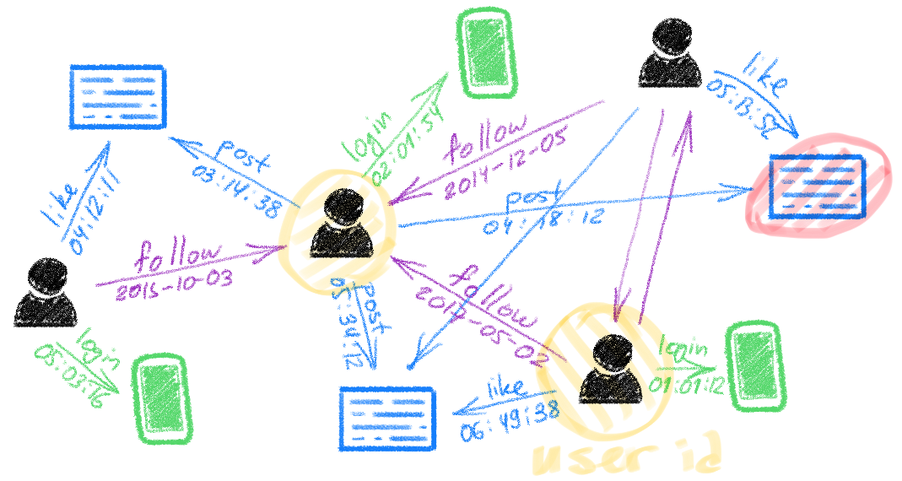
Graph For following users and liking posts
Implementing graph data model on our Co-op page. Our pitch is to implement a graph data model on our Co-Op page which will not only improve the efficiency flow of our page but be able to improve the user experience for the students by getting them a clear path for opportunities towards a career job

Slide 3
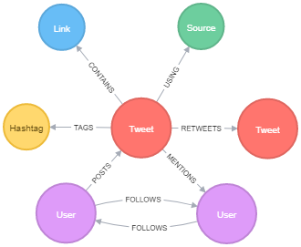
Example of twitter graph

Slide 4
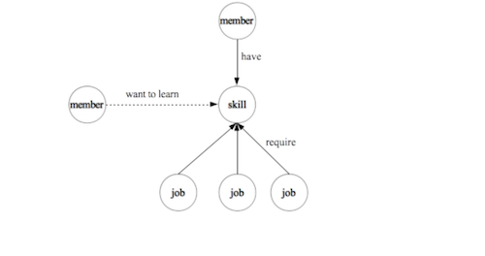
Example of how graph can be used by job skill nodes
Skills recommendations:
Based on student's skills in their profiles and skill goals they are interested in
These skills can be contained into category nodes that connects to job posting nodes that require these skills.
Using this data in the graph we can recommend students job postings related to the skills that they are interested in or have

Slide 5


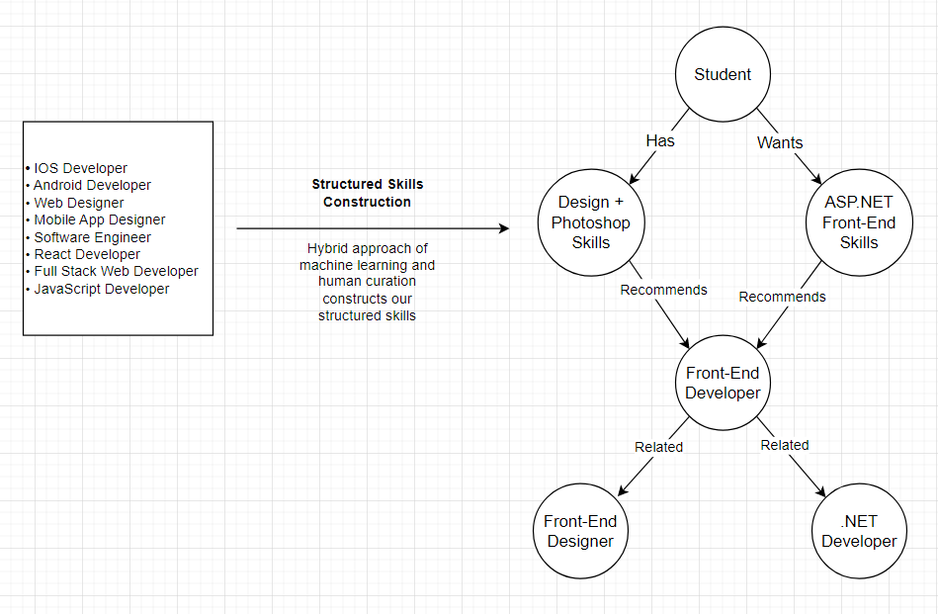
How our implementation works!

Slide 6



How the data will be used?
Students
Companies
Sensitive information
The data will be taken from student’s preferences on tech skills and while this data will be very useful to our page it does contain personal information that is attached to each student.
The data from companies will also be used for job posting information and this data will also be used to recommend students that similarly match the job posting.
While the data that will be taken from both companies and students will greatly help our page, the legal issues that may arise will be how we are securing this information from malicious users.

Slide 7
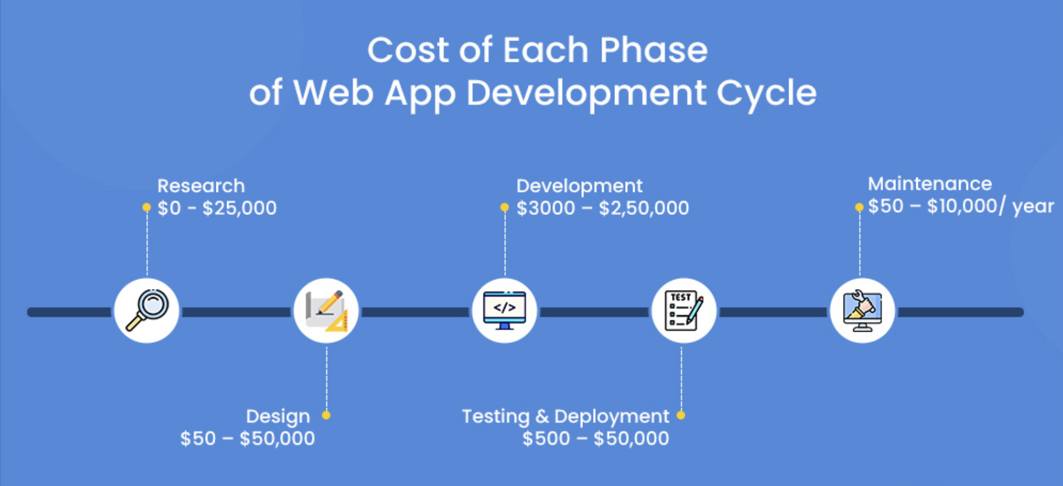
Implementation costs
BASE DEVELOPMENT COSTS: $3600 ON-GOING DEVELOPMENT COSTS WITH MAINTENANCE: $50,000

Slide 8

QUESTION AND ANSWERS
“We can build a world where everyone has access to opportunity not because of where they were born, who they know, or where they went to school, but because of their actual skills and ability” – Ryan Roslansky LinkedIn CEO
Building this feature into our webpage will be a critical part in helping make a skill-based labor market a reality.

